Slide 1


Slide 2
3rd Sprint
1ST SPRINT GOALS:

Slide 3
Nth Sprint
Recap
What is Val Uni?
VAL-UNI is an Information-based platform where students can share their experiences and exchange knowledge and feedback regarding professors and courses.

Slide 4
Third Sprint Objectives
Tasks Set
Tasks Done

Slide 5
Tasks Set
Create Review Form
Parametrized Review Prompt
Optional Detailed Review
Activate Dark Mode
Setting Up Queries
Home Page
Course Review Page
Teacher Review Page
Editing Reviews
Masking APIs
Linking New Reviews with Database
Linking Pages with Fetched Queries
Fixing Old Documentation
Tasks Done

Slide 6
Tasks Done
Create Review Form
Setting Up Queries
Home Page
Course Review Page
Teacher Review Page
Linking New Reviews with Database
Linking Pages with Fetched Queries
Fixing Old Documentation
Tasks Set

Slide 7
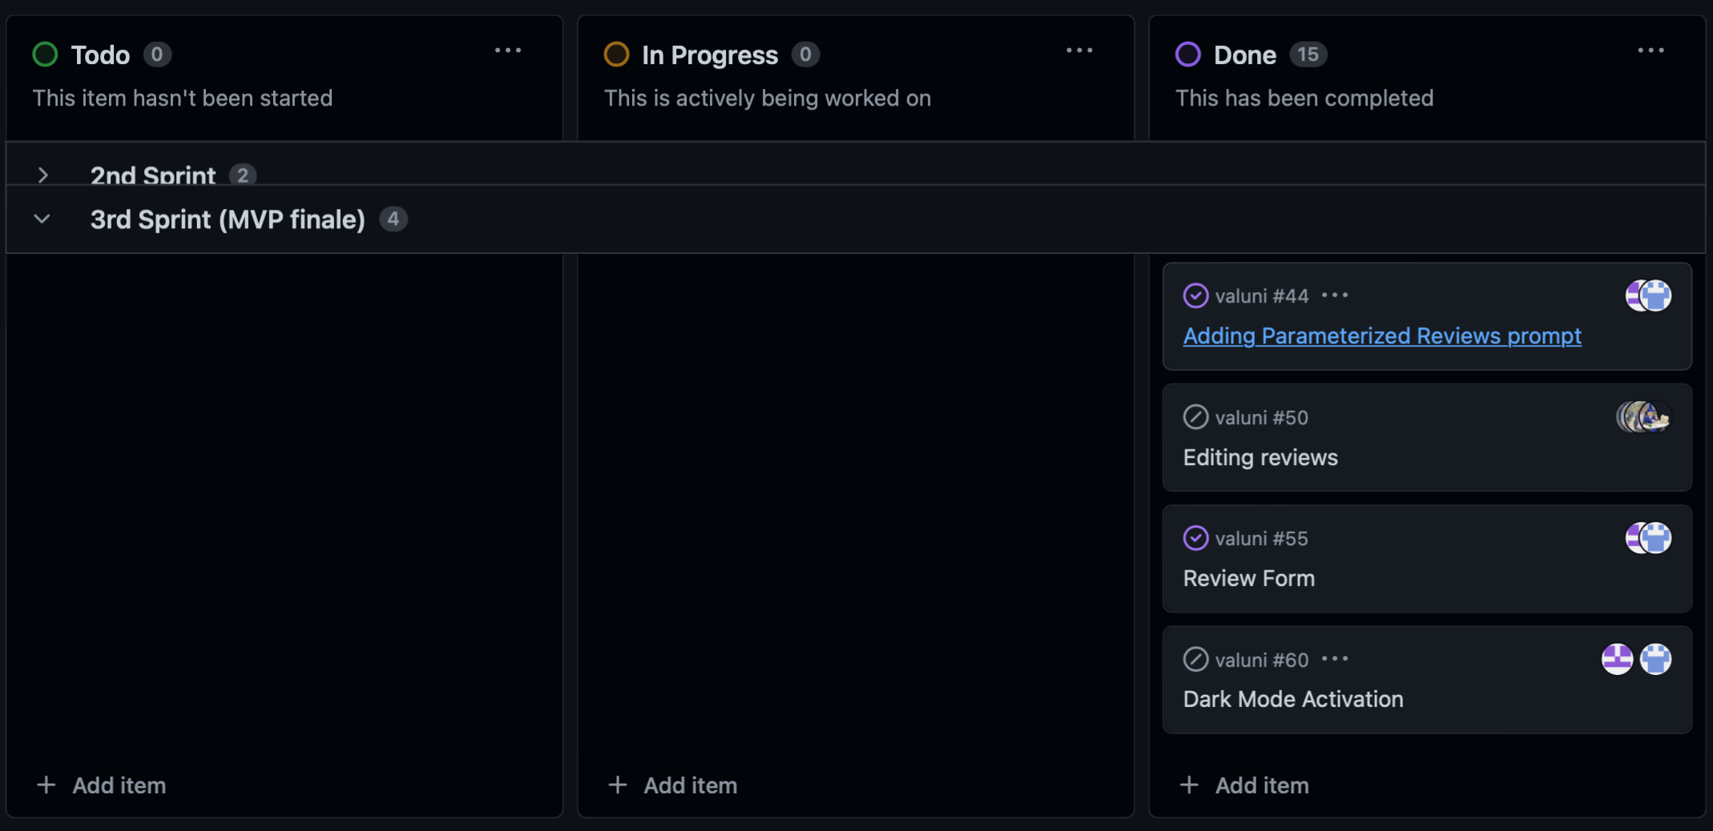
Sprint Board
Both Editing Review & Dark Mode issues were closed as unplanned and will be reopened in future sprints

Slide 8
Sprint Board

Slide 9
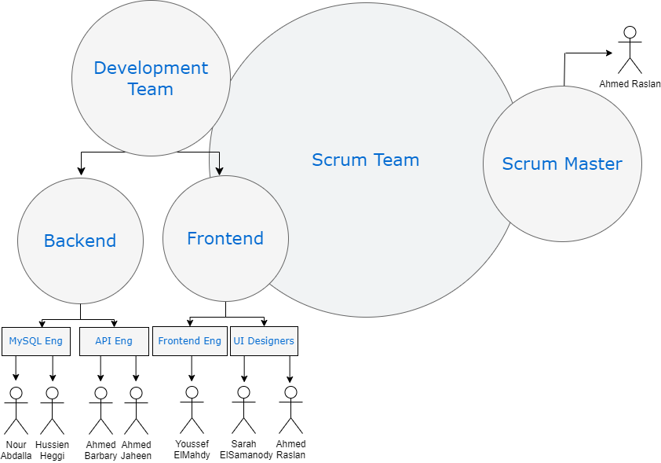
Scrum Methodology

Slide 10


Obstacles Faced
Process of Creating the Form
Handling Queries
Learning Curve
Timing & Multitasking

Slide 11
Obstacles Faced
Handling Queries
Learning Curve
Timing & Multitasking
Main Issue:
The code required many refactoring which was time consuming
Reason:
The familiarity with technology being used is not very strong
How we faced it?
Gave the process its time as it is a vital part of our product and we had to postpone less important tasks for later. (PRIORITIZATION)
Process of Creating the Form

Slide 12
Obstacles Faced
Learning Curve
Timing & Multitasking
Main Problem:
We faced bugs that were not noticed in previous sprints
Reason:
Our data needed to be manipulated in many ways and consistent all at once , so some bugs were untraceable and only found when filtering queries
How we faced it?
Gave debugging the time it needed. Focused on immediate checking and communicating back and forth to trace and eliminate all errors
Process of Creating the Form
Handling Queries

Slide 13
Obstacles Faced
Timing & Multitasking
Main Problem:
Complexity of our product is increasing which resulted in more time wasted in research before implementation
Reason:
Lack of familiarity and incompetence especially for backend developers as they had to integrate database with frontend technology
How we faced it?
Our backend to frontend developer ratio served us right and simultaneous research was done to have more diversity and try speed up the work. The scrum master helped backend developers get more familiar with frontend technology
Pair Programming & Communication
Process of Creating the Form
Handling Queries
Learning Curve

Slide 14
Obstacles Faced
Process of Creating the Form
Handling Queries
Learning Curve
Timing & Multitasking
Main (HUGE) Problem:
Juggling work , midterms & studying
Reason:
The tasks in this sprint required proper communication and time and being able to find common gaps and times to work was a hassle.
How we faced this?
Worked with what we got , pair programming, breaking down things into subtasks

Slide 15
Testing of VALUNI:
Dependent on our git repos branches : dev-f, dev-b, test, release
Main Functionalities are in dev-f , dev-b
They include unit testing of separate react components (NodeJs APIs & Preliminary overall testing)
Initiating pull requests for more intensive testing
If faults are detected, run unit tests and check defected component communication
Apply modular tests on each component
Testing process is iterative until no more conflicts and we are satisfied
Then pull request is reviewed then by 2 members in order to ensure that nothing was missed
Release branch receives the finalized version only after approval of 2 members

Slide 16
Plans for Future:
Improve user experience
Editing reviews
Deleting reviews
Dark mode
Portability & Security
Compatible with different platforms
Partnership
Upgrade the mock up data of prototype by partnering up with universities and launching the application in real use

Slide 17
Tips for the upcoming work:
Construct plans for code refactoring to accommodate new features
Prioritize the organization for the database spreadsheets
Automated generation of data using scripts
Set guidelines (dos & don’t s) for more readable codes
Regulate daily meetings
All members should constantly focus on the SELF principle in IEEE for the greater benefit of our product and this will help eliminate coding redundancy

Slide 18
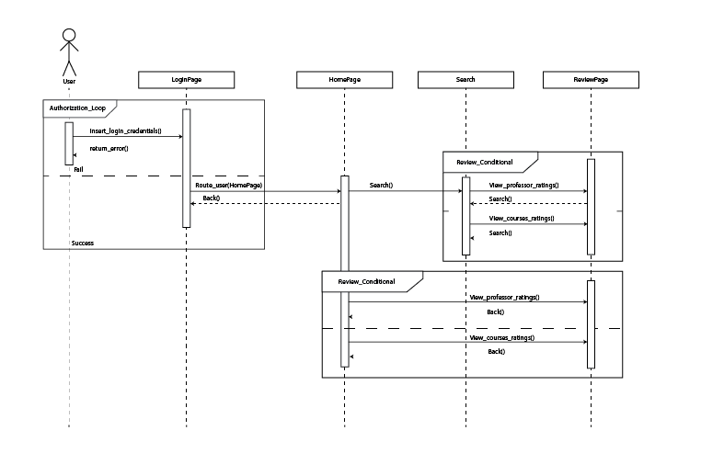
Sequence Diagrams: UI Navigation

Slide 19
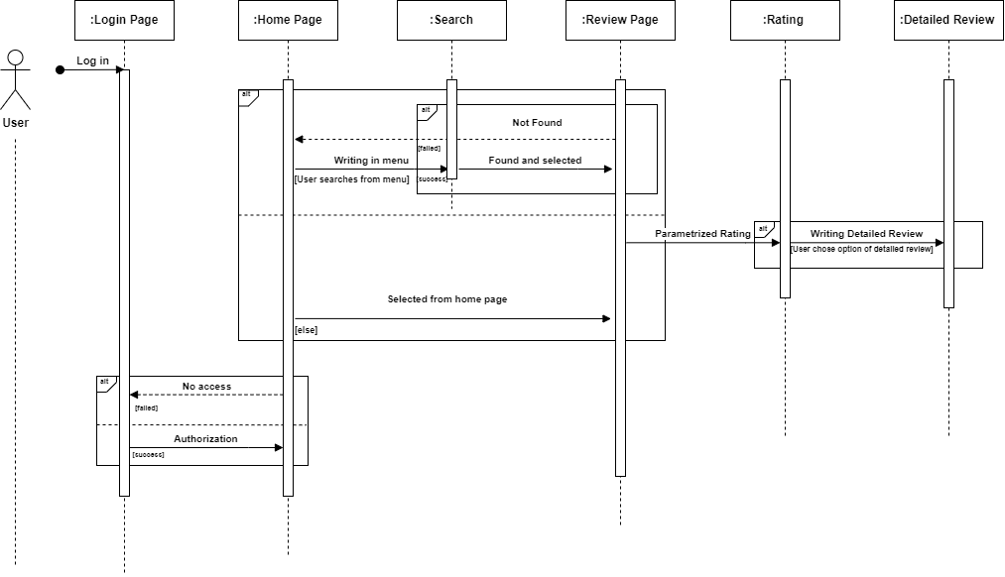
Sequence Diagrams: Writing Review

Slide 20
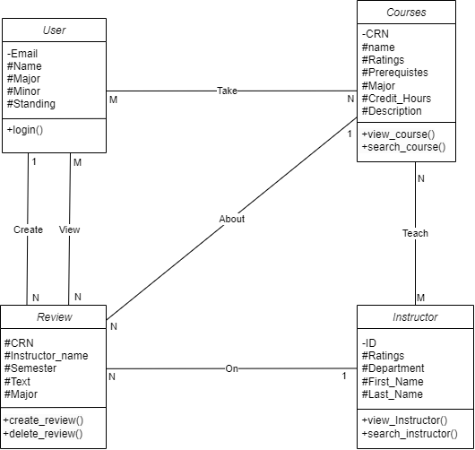
Class Diagram

Slide 21
We are
Thank you for listening!

